Slide 1
Spatio-Temporal Bayesian Modeling for Mobile Edge Computing
Presenter: Laha Ale
Instructor: Dr. Jose Guardiola

Slide 2
Agenda
Motivation
Data Clean
Data Exploratory
Geospatial Statistics
Spatio-Temporal Bayesian Modeling
Future Work

Slide 3
Motivation

Slide 4
Motivation
Content Offloading
Computing Offloading
Content Recommendation
Path Planning
Mobile Station Allocation
Other Service

Slide 5
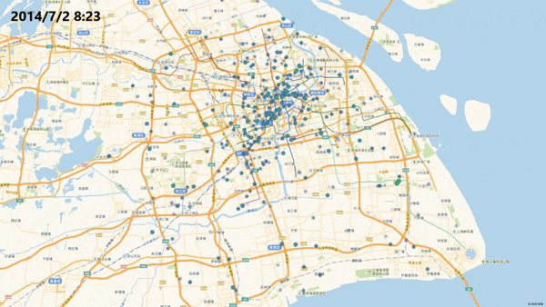
Spatial-Temporal

Slide 6
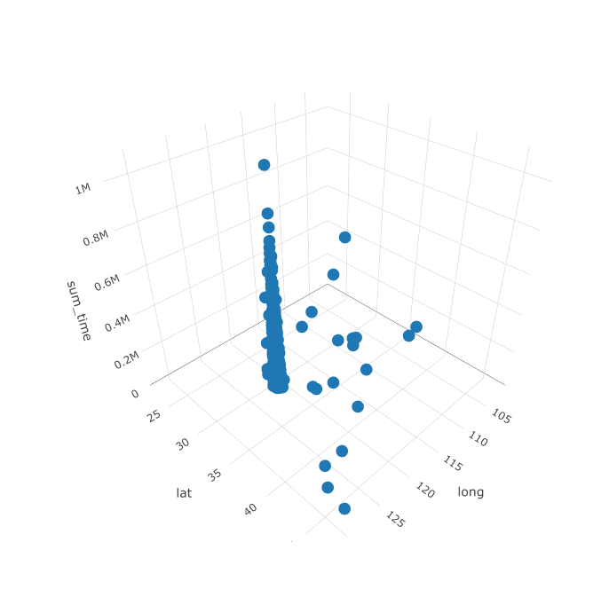
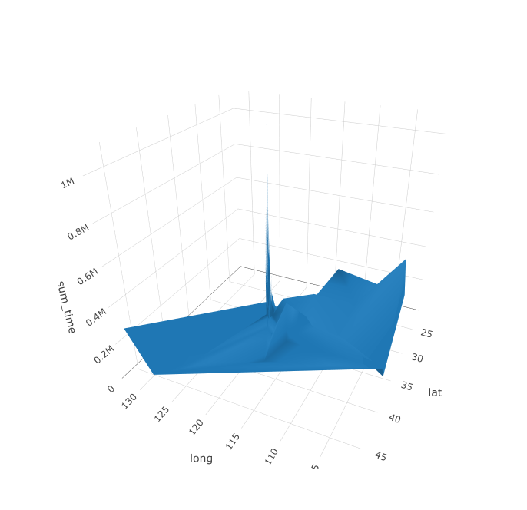
Data Clean

Slide 7
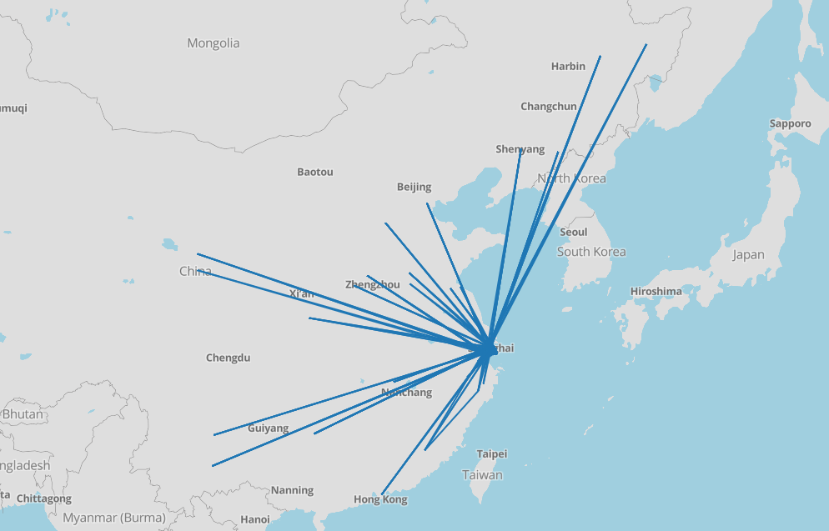
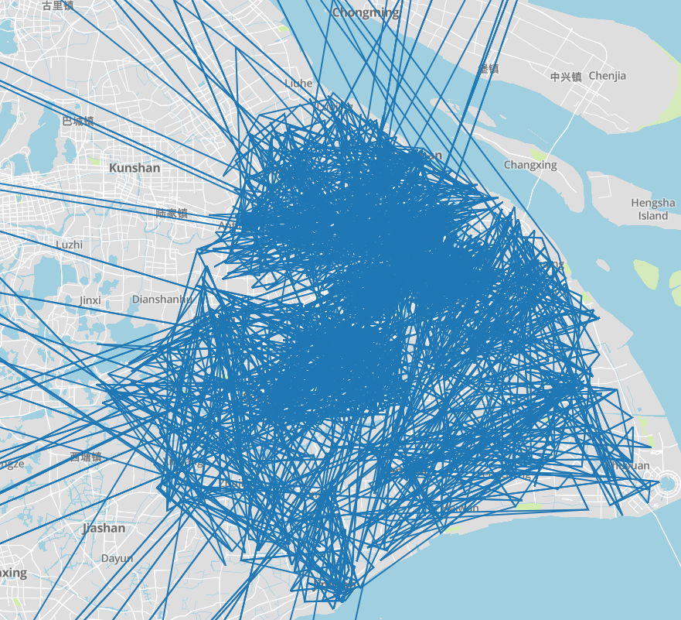
Data Exploratory

Slide 8
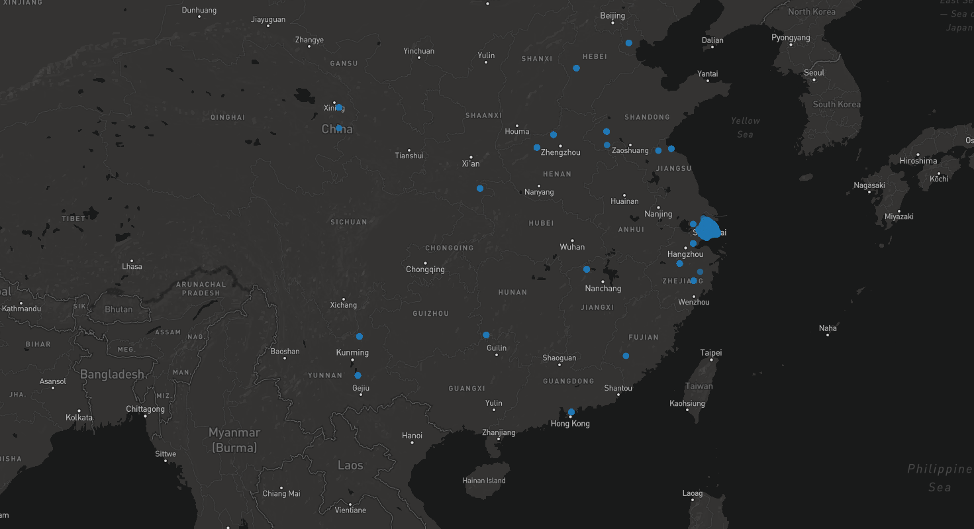
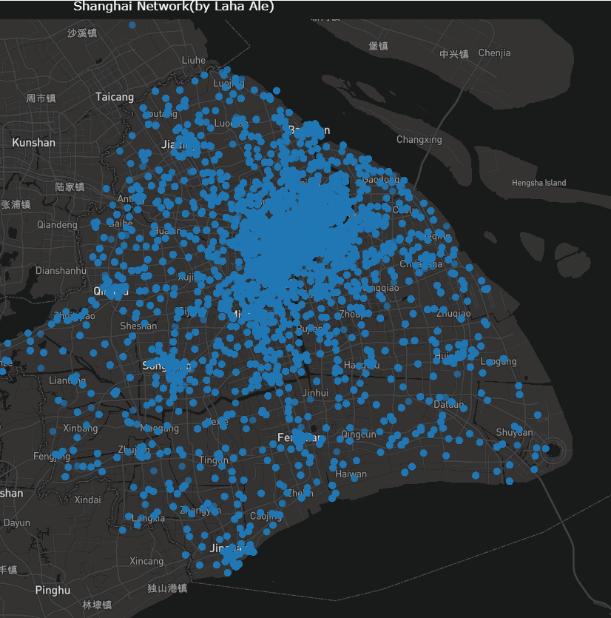
Data Exploratory

Slide 9
Focus?

Slide 10
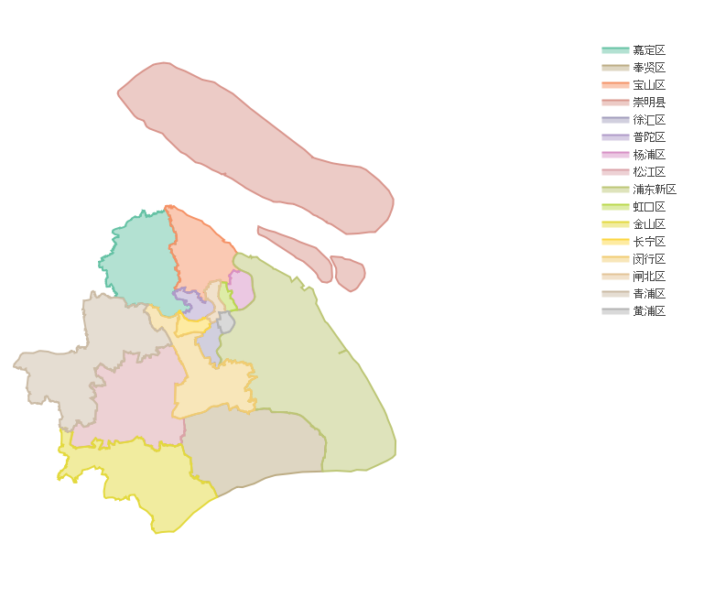
Remove outliers

Slide 11
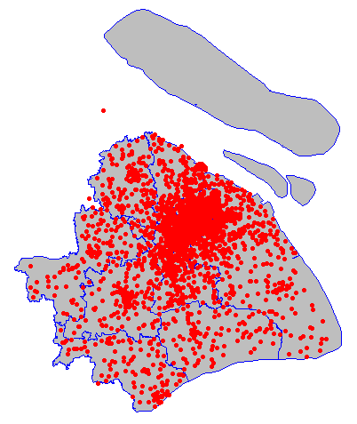
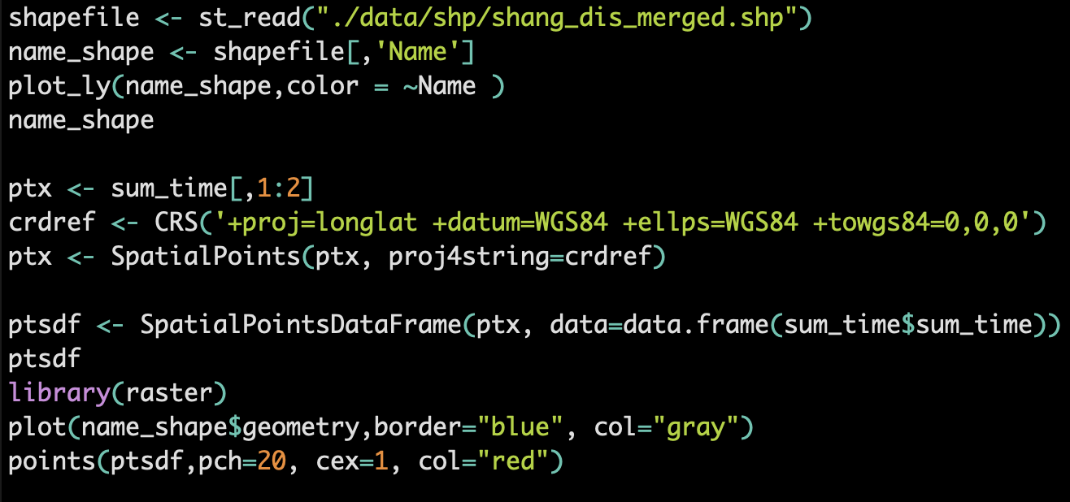
Remove outliers

Slide 12
Clean

Slide 13
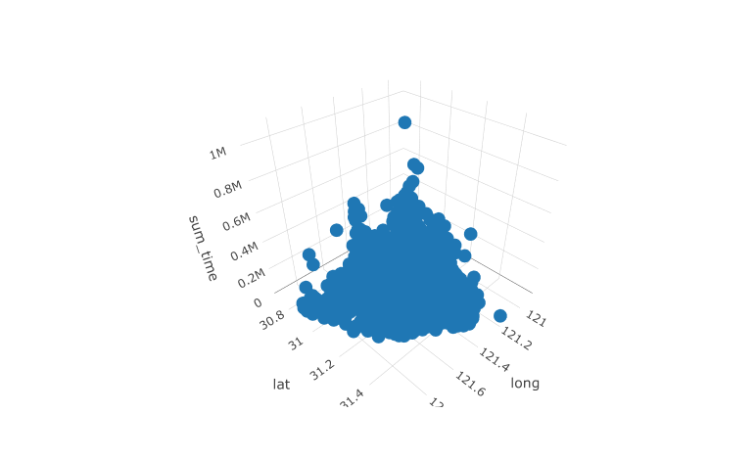
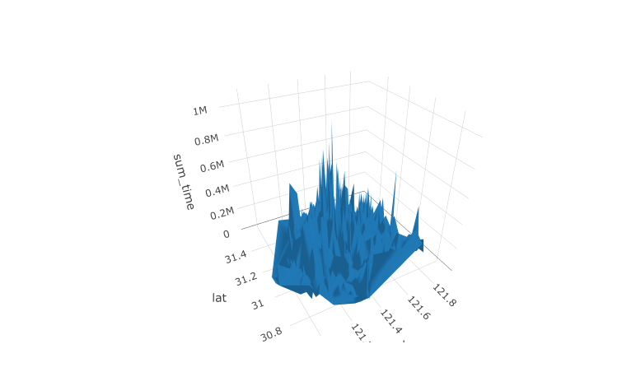
After Clean

Slide 14
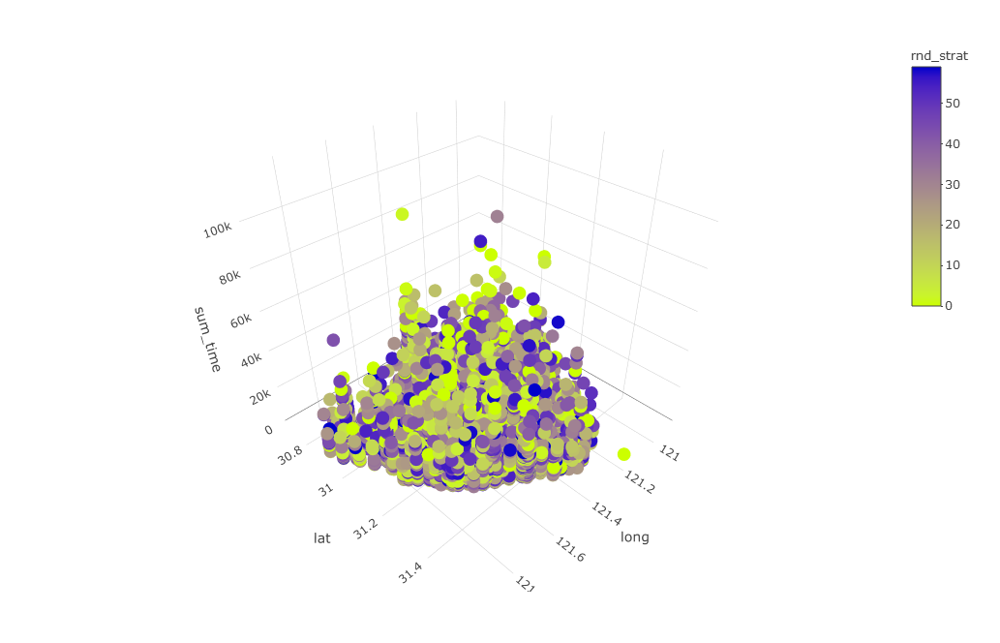
Grouped By Minutes

Slide 15
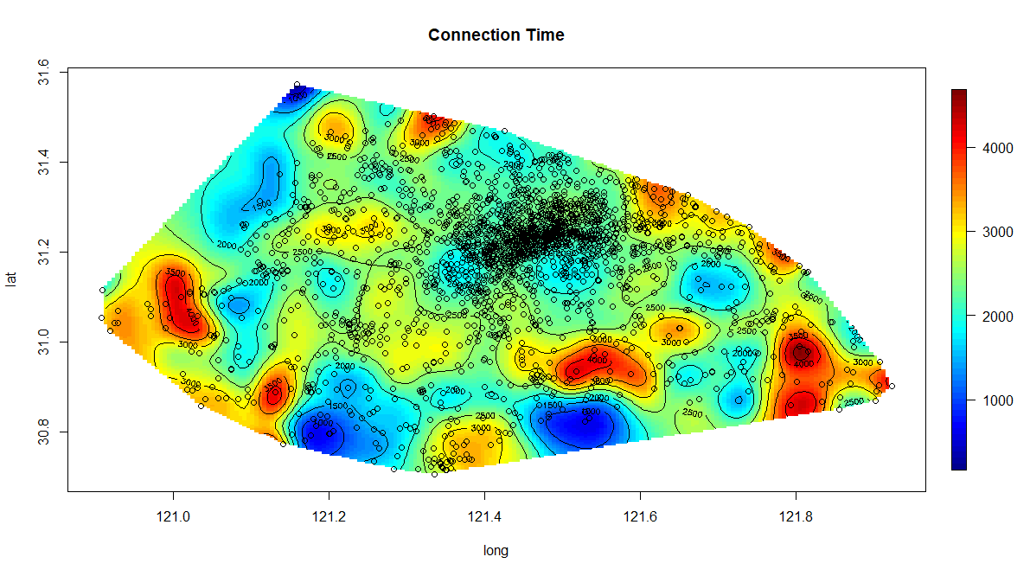
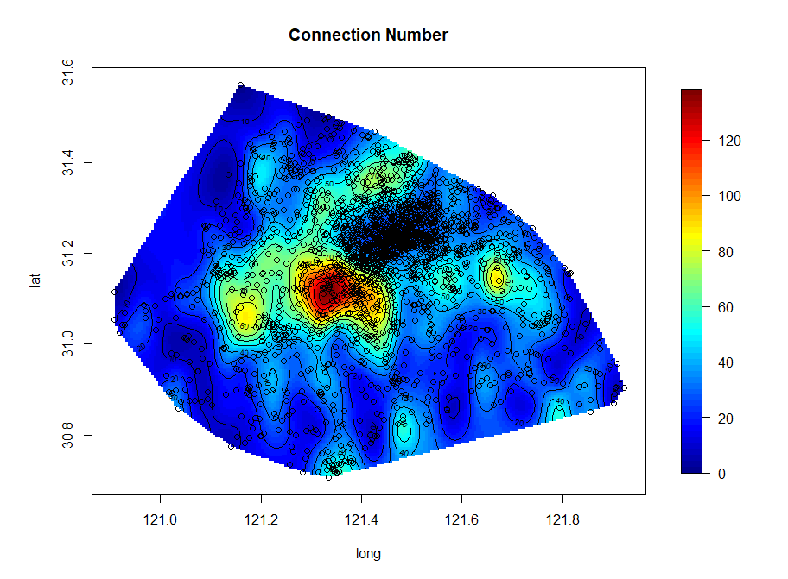
Interpolation

Slide 16
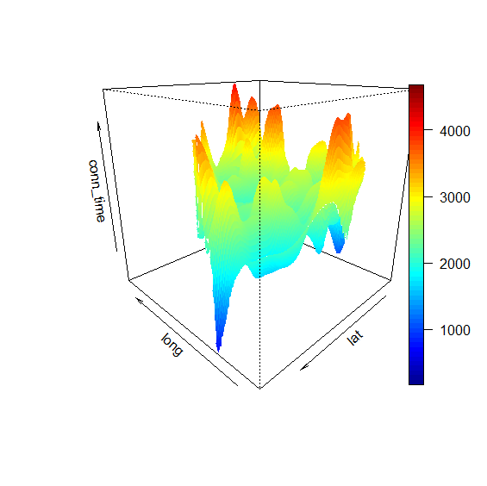
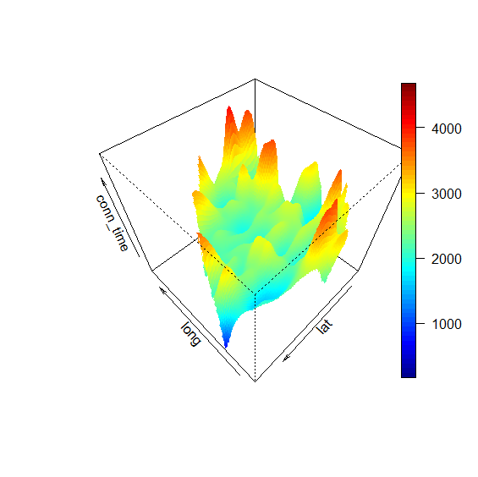
Connection Time

Slide 17
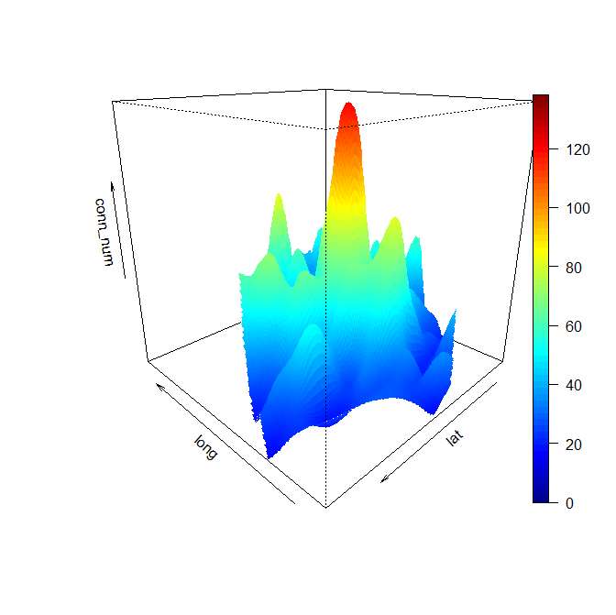
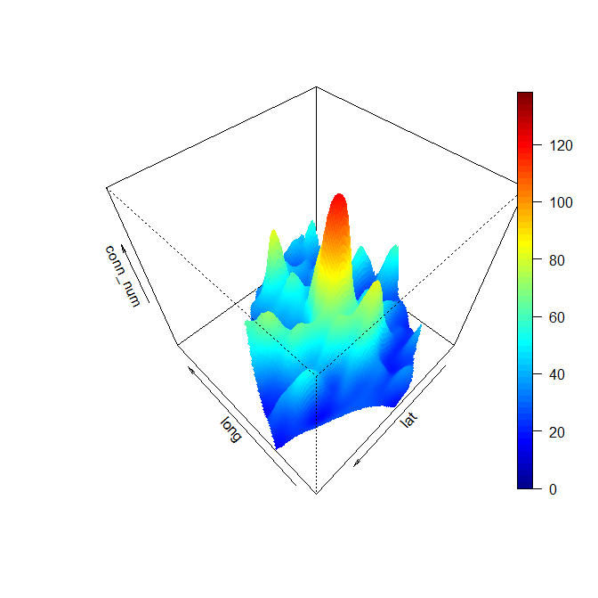
Connection Number

Slide 18
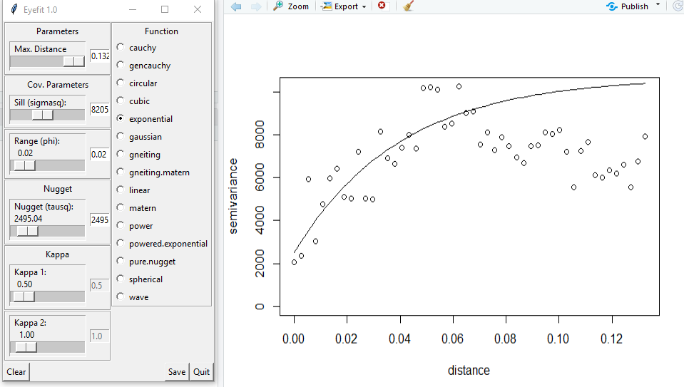
Variogram

Slide 19
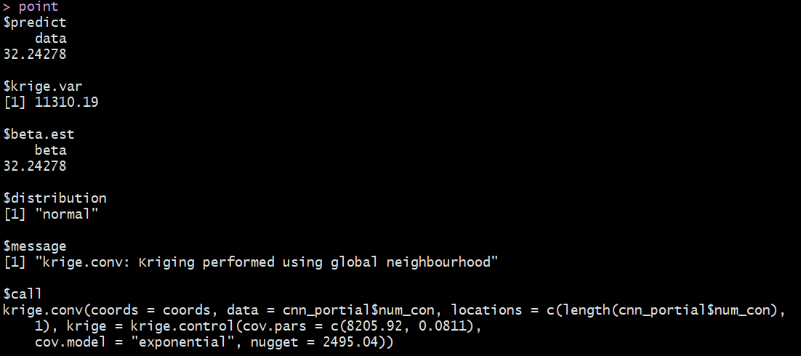
Kringing
"The 95% PI is between -176.202001154899 and 240.687556589459"

Slide 20
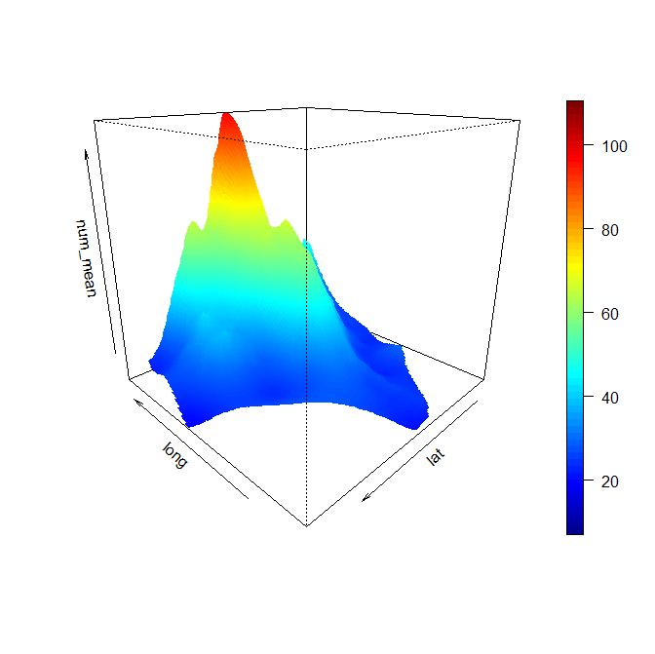
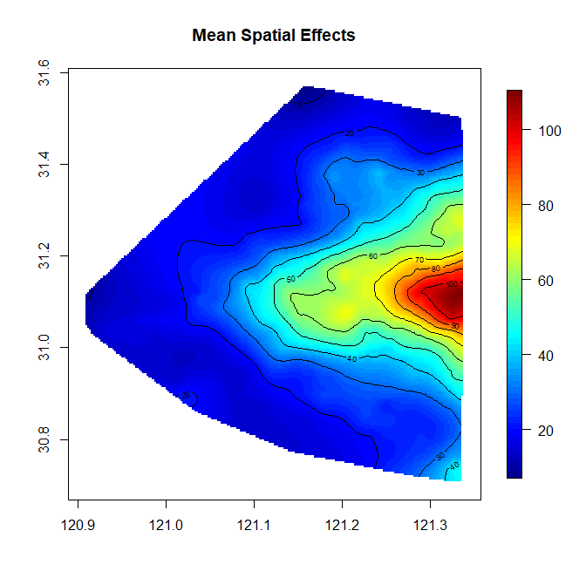
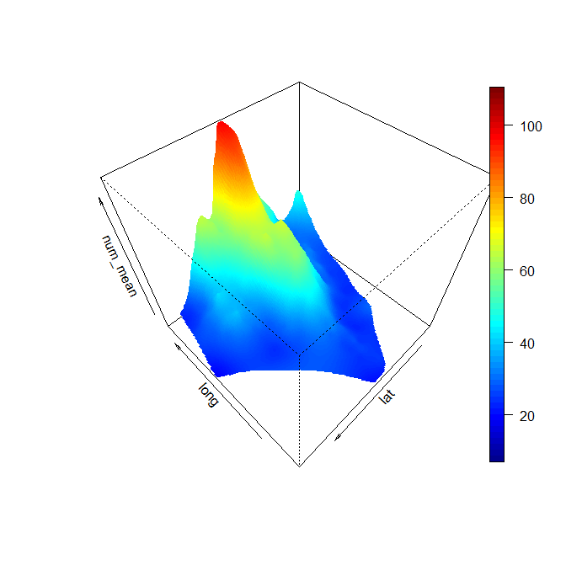
Bayesian-Mean

Slide 21
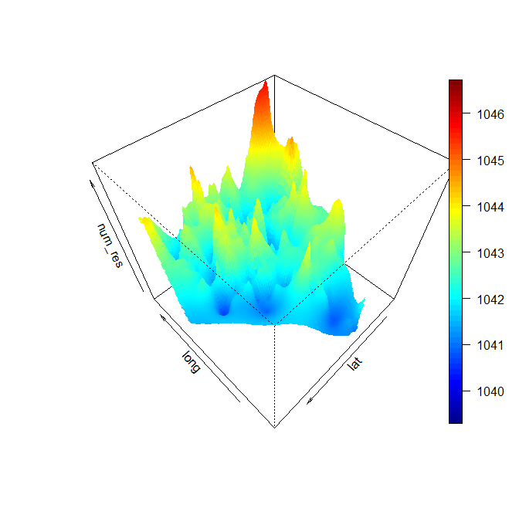
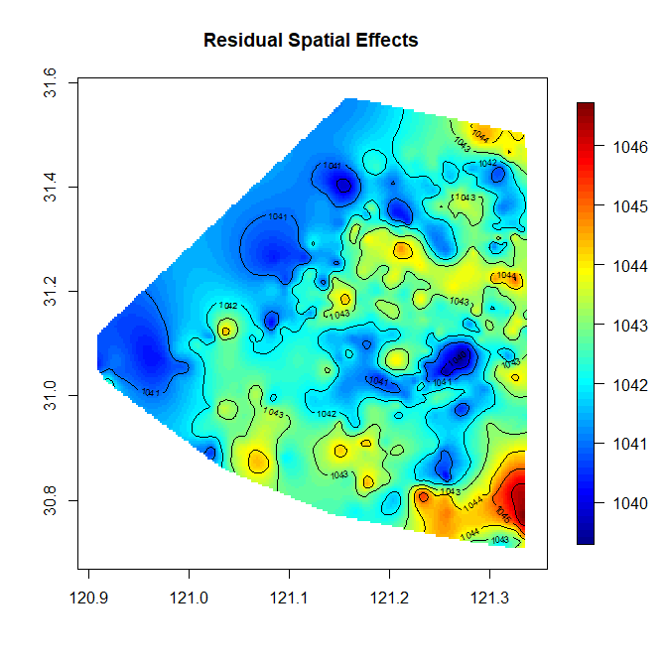
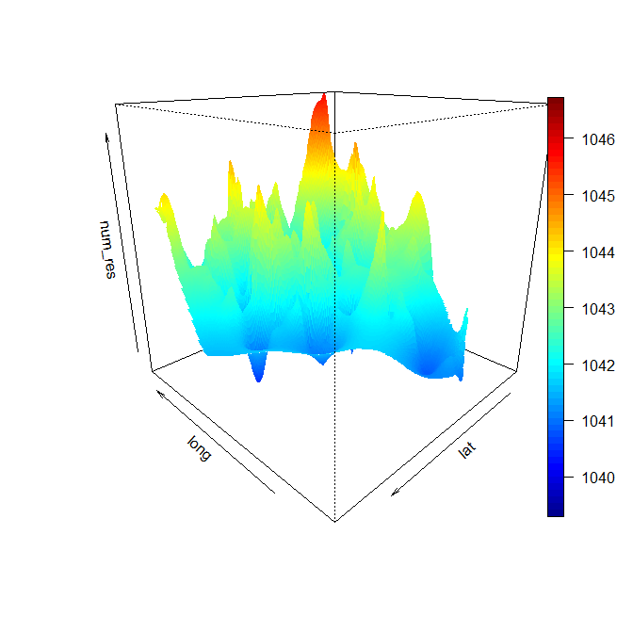
Bayesian-Residual

Slide 22
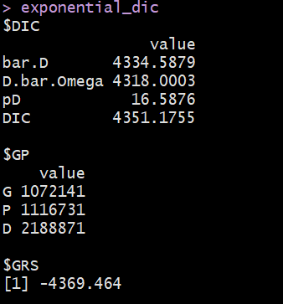
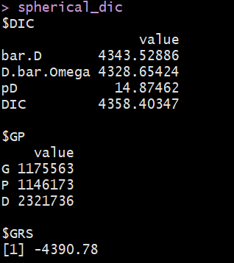
Bayesian- Exponential vs Spherical

Slide 23
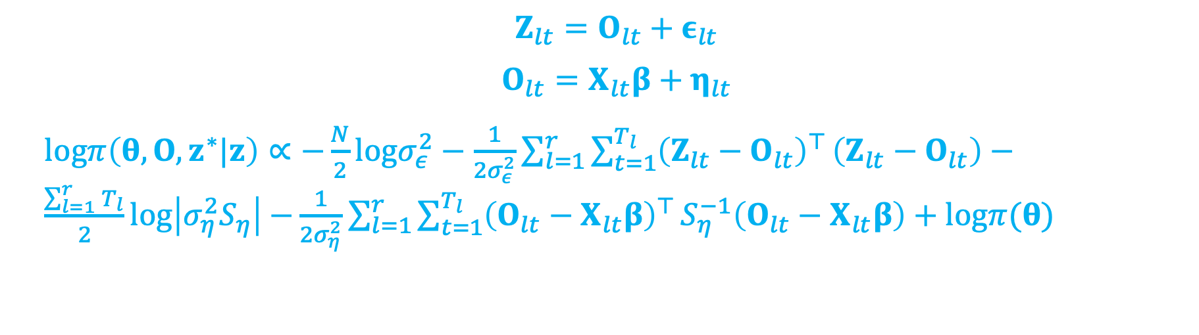
Spatio-Temporal Bayesian-GP
$$Z_{lt}=O_{lt}+ε_{lt}$$
$$O_{lt}=X_{lt}β+η_{lt}$$
$logπ\left(θ,O,z^{∗}|z\right)∝−\frac{N}{2}logσ_{ε}^{2}−\frac{1}{2σ_{ε}^{2}}\sum_{l=1}^{r}{\sum_{t=1}^{T_{l}}{{\left(Z_{lt}−O_{lt}\right)}^{⊤}}}\left(Z_{lt}−O_{lt}\right)−\frac{\sum_{l=1}^{r}{T_{l}}}{2}log\left|σ_{η}^{2}S_{η}\right|$ $−\frac{1}{2σ_{η}^{2}}\sum_{l=1}^{r}{\sum_{t=1}^{T_{l}}{{\left(O_{lt}−X_{lt}β\right)}^{⊤}}}S_{η}^{−1}\left(O_{lt}−X_{lt}β\right)+logπ(θ)$

Slide 24
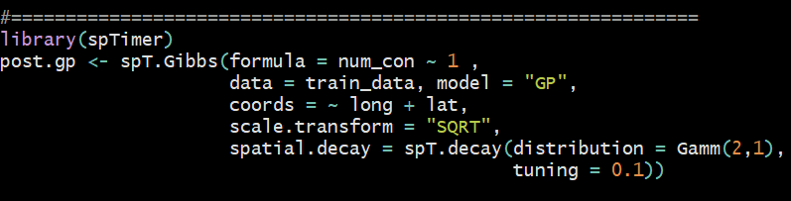
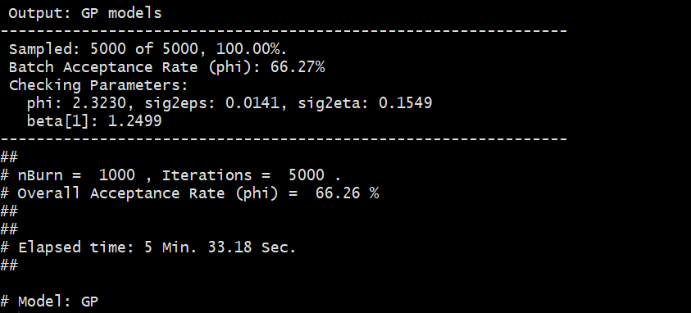
Spatio-Temporal Bayesian Model

Slide 25
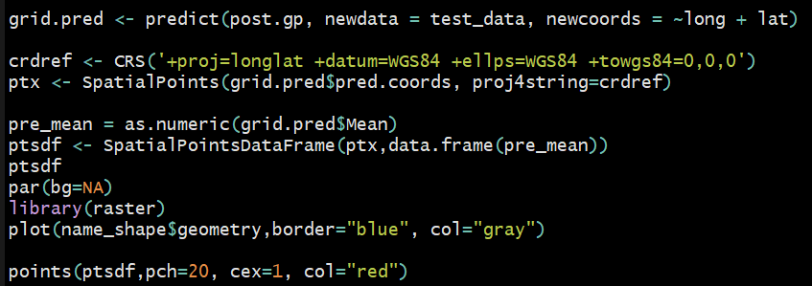
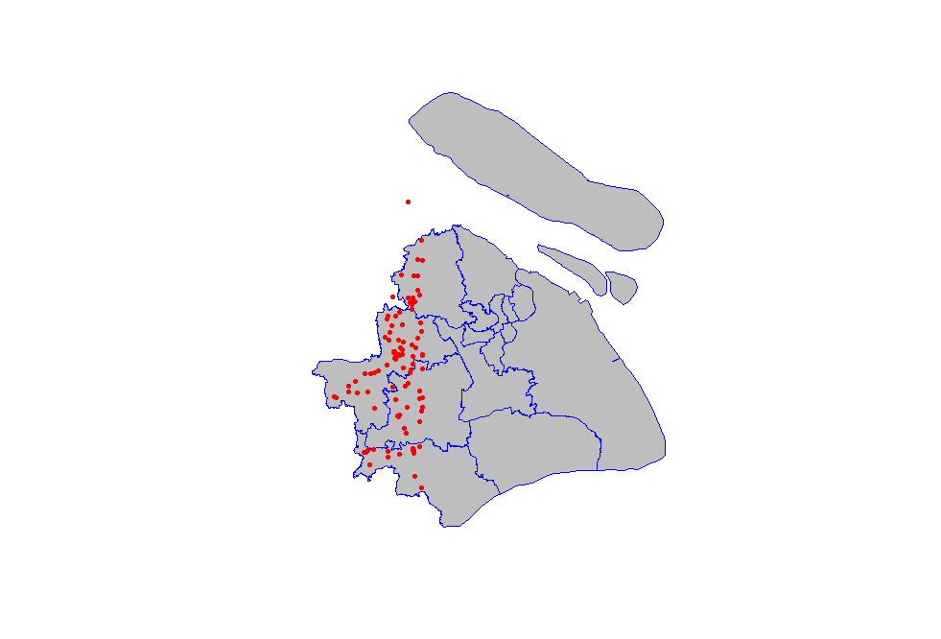
Spatio-Temporal Bayesian Predict Points

Slide 26
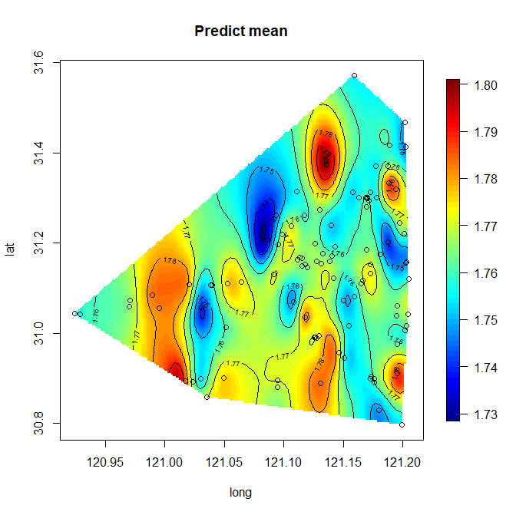
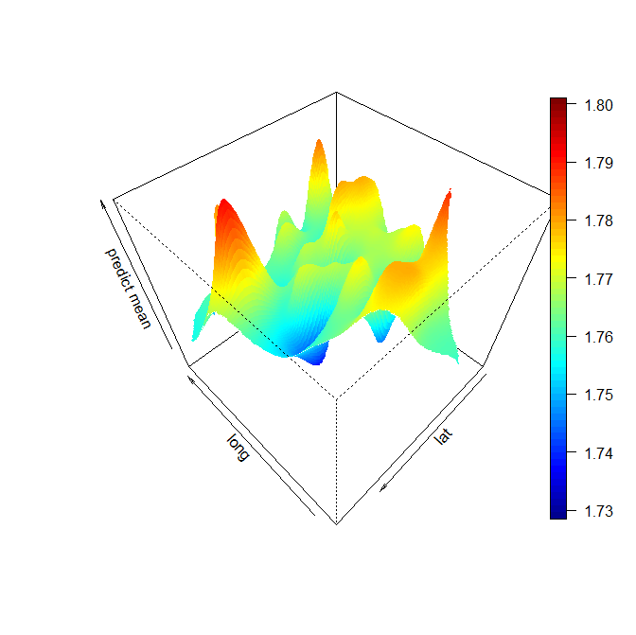
Spatio-Temporal Bayesian Prediction

Slide 27
Future Work
Geospatial Data Mining
Spatio-Temporal Bayesian Modeling
Online Learning
Recurrent Neural Network

